Slide 1
Go over thesis and make sure you included all the stuff written there in each section here
Add refrences

Slide 2


Show some sensitivity!
Using motion tracking to explore unconscious measures
Khen Heller
Under the supervision of Liad Mudrik

Slide 3


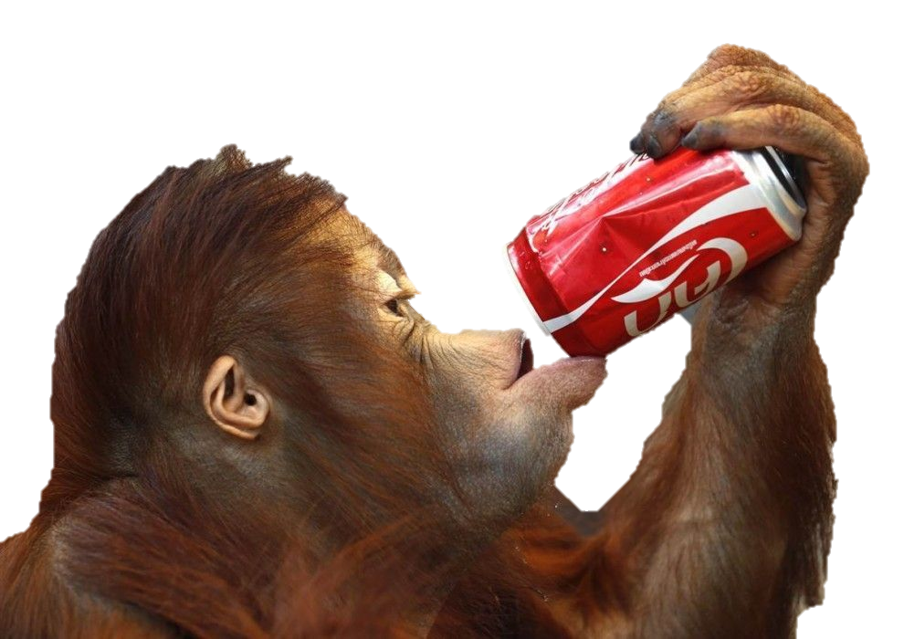

Un
conscious processing
Stimuli
Processing
Perceived
Affects Behavior
Notes:
In day to day we our brain receives a lot of information
He than processes it.
Some of is consciously perceived, and thus called conscious
And as a result affects our behavior.
But we don’t perceive everything we processes,
Some of the information doesn’t enter our awareness,
But can still affect our behavior (references)
This type of processing is called unconscious

Slide 4



Un
conscious processing
Stimuli
Processing
Perceived
Affects Behavior
Degrading physical properties
Suppression with salient stimuli
Diverting attention
Notes:
When one wants to research this type of information he can use 3 methods to render it UC:
degrading its physical properties (contrast, duration, intensity, size),
suppressing ti with more salient stimuli,
diverting attention.
All of which decreases visibility, but also decrease the neural response, → weaker behavioral change
How would one go about measuring the unconscious effect you ask? Well…

Slide 5
Measuring the Unconscious effect
Priming paradigm
Congruent
RADIO
RADIO
RT
radio
Time
radio
Subjective Objective
Natural / Artificial
How well did you see the first stimuli?
On a scale of 1-4
CLOUD / RIVER
1 2 3 4
Notes:
The most prominent method is the priming paradigm with a Keyboard RT measure.
A prime precedes the target, is rendered invisible, e.g. by masking with salient stimuli
Participant perform a task on the target, e.g. classify as artificial / natural.
To verify that prime is indeed invisible, two types of measures are available:
Subjective – participant asked about his experience of the prime.
Objective – participant is asked to perform a judgment about the prime, and the invisibility is inferred from low accuracy..
Prime,target can be either
congruent – evoke the same response, facilitation

Slide 6
Measuring the Unconscious effect
Priming paradigm
Incongruent
Congruent
CLOUD
RT
Time
radio
Natural / Artificial
Notes:
Or incongruent – evoke opposite responses, restriction

Slide 7
Measuring the Unconscious effect
Priming paradigm
Incongruent
Congruent
Congruency effect
CLOUD
RT
Time
radio
Natural / Artificial
Greenwald et al. (1996); Van den Bussche et al. (2009)
Notes:
To Measure the effect we compare the RT between the conditions and that difference gives us the congruency effect.
It implies that the prime was unconsciously processed.
Problem is this effect is usually very small when recorded with a keyboard (add references)

Slide 8




Consequences of Low Sensitivity
Problem: Common measure can’t pick up the effect
Consequence: controversy
Explanation: Underestimation of the effect
Solution: Increase sensitivity
Contradicting findings:
Hesselmann & Knops (2014)
Kouider et al. (2009)
Moors et al. (2016)
Mudrik & Biderman (2017) Peters & Lau (2015)
Notes:
The problem with a small effect is that it is hard to detect,
Which leads to contradicting findings (references)
that in turn evoke controversy on the scope of UC processing. (references)
Some say:
Unconscious processing can perform high level functions and have a small but existing affect on behavior, (references)
Others say:
It is negligible, and the parts of it that can be found can be explained by conscious influence. (references)
One explanation that can account for the contradicting findings is methodological limitations that cause an underestimation of the UC effect
solution - more sensitive measure
Controversy:
(Desender & Van Den Bussche, 2012; Hesselmann & Moors, 2015; Michel, 2019; Peters et al., 2017; Peters & Lau, 2015)

Slide 9
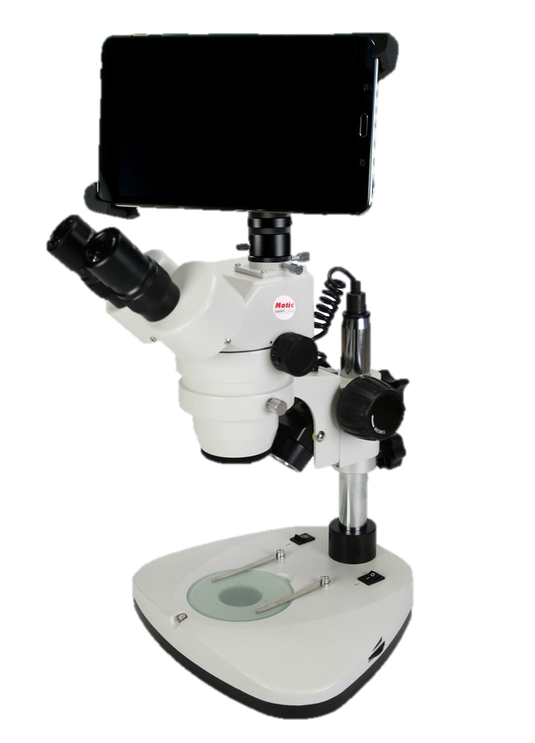
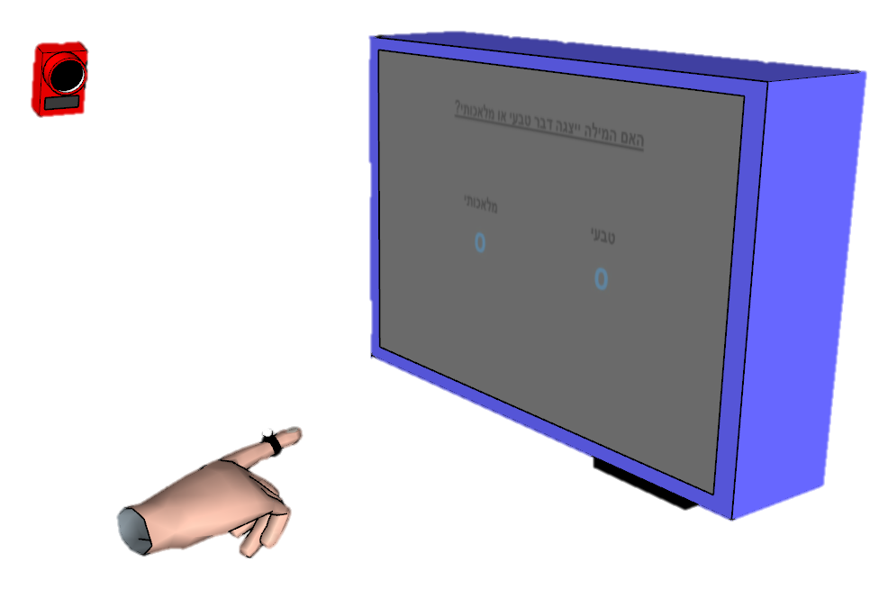
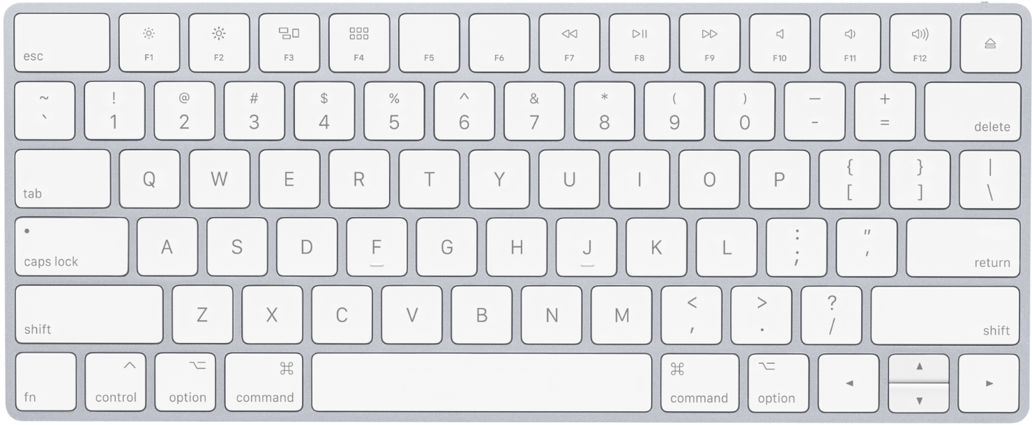
Improving Sensitivity
Single value
Post decision
“Poor” – RT, accuracy
Continuous
Online
“Rich” – RT, onset, MAD, velocity…
Notes:
One option for improving sensitivity is to use motion tracking,
Which has become a popular tool for probing unconscious effects. (references)
This tool has three main advantages over the usual keyboard response measure:
(references)
Continuous – more suitable for ongoing cognitive processes
Rich – allows to capture effect which aren’t detectable in other parameters of the response.

Slide 10
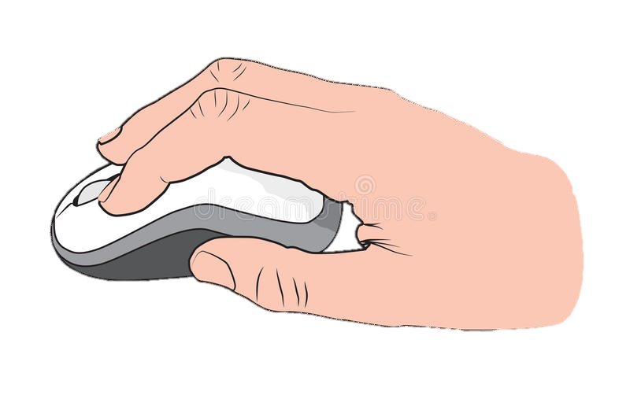
Xiao et al (2015)
Time
3 \ 3
Same / Different
VS
t(35) = 1.92, p = 0.06, d = 0.65, CI_{d} [0.16, 1.14] t(27) = 5.13, p < 0.001, d = 1.97, CI_{d} [1.31, 2.64]
Notes:
To date,
Only one study directly compared them (reference)
Importantly, it found a robust weffect when using mouse tracking,
While the keyboard effect was only marginally significant.

Slide 11
Xiao et al (2015), Limitations
Limited awareness measure:
Awareness measured on separate block from main task
Low number of awareness trials
Correlation analysis underestimates awareness
d’ > 0
Mouse tracking:
Constrains movements
Longer movement duraiton
Smaller curvatures
Lower velocity
Slower reponses to COM
Less intuitive
Notes:
Limitations:
Awareness:
Estimating awareness in a separate block doesn’t allow to draw conclusions about awareness in single trial level.
96 trials isn’t enough to detect awarenesss according to work in our lab.
To estimate awareness they estimated the correlation between the awareness score (d’) and the performance score (AUC/RT).
Since no correlation was found and the intercept at zero awareness shows a congruency effect larger than 0, they conclude UC processing occurred.
This analysis has been highly criticized since the correlation is limited by the reliability of each measure.
Therefor it understimates awareness.
d’ (sensitivity to prime) seems to be larger than 0.
Tracking:
Constrains movements - Mouse require remapping to 2D space, which might constrain movement, and thus affect the rrajectory and timing and prevent the effect from being expressed.
Less intuitive – therefor more effortfull and thus might be less likely to express fluctuations in decision (reference)

Slide 12
Xiao et al (2015), Limitations Current Study
Awareness measure:
Awareness measured on separate block from main task
Low number of awareness trials (96)
Correlation analysis underestimates awareness
d’ > 0
Mouse tracking:
Constrains movements
Longer movement duraiton
Smaller curvatures
Lower velocity
Slower reponses to COM
Less intuitive
Rigorous awareness measures
Subjective + Objective
240 trials, for each measure
Estimate at single trial level
Reaching movements
Free movement
Intuitive
Notes:
My study includes a rigorous awareness testing procedure that combines both
a subjective measure thawareness on single tial level,
And objective awareness measure that overcomes the criterion problem
Reaching movements
Do constrain movement,
Is more intuitive

Slide 13
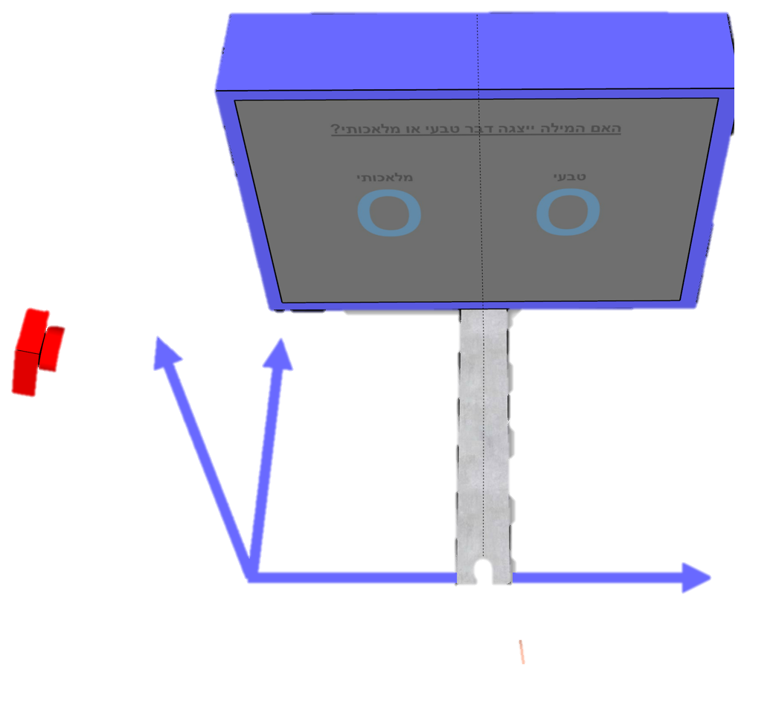
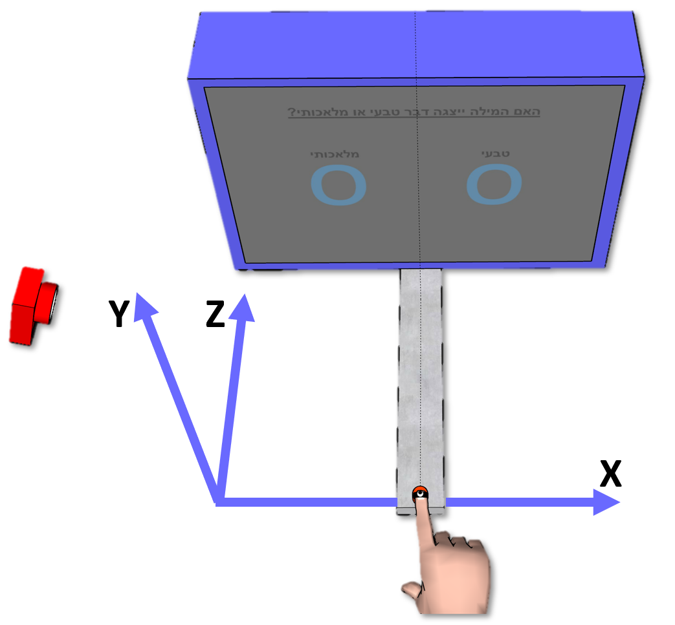
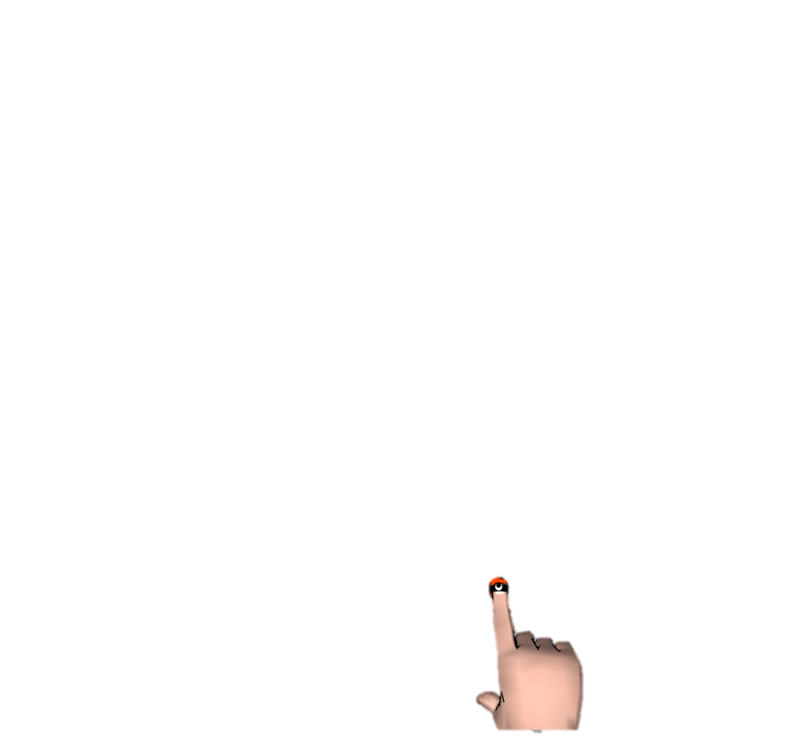
Current Study - Paradigm
Congruent - Same word
Incongruent - Different word
Different category
Congruency effect = Con - Incon
1000ms
270ms
30ms
Artificial Natural
TREES
RADIO
radio
30ms
Time
30ms
Artificial Natural
radio
0-1500ms
RADIO PHONE
How well did you see the first stimuli?
On a scale of 1-4
1 2 3 4
Notes:
All exp followed Dehanea (reference)
In this paradigm,
Prime - Prime is shortly displayed between very salient masks, which renders it invisible.
Target - Afterwhich target is displayed and sub classifies it as natural / artificial
FC – afterwords he is asked to identify the priem between two options
PAS – rate visisbility
Congruenct condition,
Incongruenct condition,
Congruency effect reflected by diff between trajectories

Slide 14

Current Study - Measuring the effect
Reaction time Movement duration
Changes of Mind Distance traveled
Reach area
Screen
Screen
Proportion
Of Z traveled
Proportion
Of Z traveled
Euclidean distances
Trajectory samples
X
X
Screen
Screen
Screen
Reach Area
Right Path Area
Right Path Area
Left Path Area
Average Path Right
Average Path Left
Lowest X value
Lowest X value
Notes:
We used 6 variables to measure this difference.

Slide 15
Current study
Pilot Experiment 1
Reaching
Pilot Experiment 2
Reaching
Exploratory
Confirmatory
Pilot Experiment 3
Reaching
Experiment 4
Reaching + Keyboard
Notes:
Three studies aimed at finding the optimal conditions for detecting an UC effect with motion tracking.
Fourth confirmatory study, that compares between motion tracking and keyboard response.

Slide 16
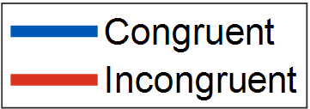

Pilot Experiment 1
Practice
1 block, with prime
Test
12 blocks, with prime
Long response time Decision made before movement
N = 10
Notes:
Explain about Graph.
No difference was observed between the con incon trajs
Trend in reach area
Explain about graph
The reason: Long RT.

Slide 17
Evidence Accumulation
Artificial Natural
TREES
radio
Time
Notes:
To illustrate why long RT might be a problem, I will use an evidence accumulation model

Slide 18
Evidence Accumulation
Artificial Natural
Long response time
TREES
radio
Artificial
Evidence
Natural
Time

Slide 19
Evidence Accumulation
Artificial Natural
Long response time
TREES
radio
Artificial
Evidence
Natural
Time
RT Limit

Slide 20
Evidence Accumulation
Artificial Natural
Long response time
TREES
radio
Reaching
Artificial
Evidence
Natural
Time
Decision
RT Limit
Reaction time
Movement duration
Reaction time
Notes:
If the sub reaches decision before movement,
Movement duration should stay the same between conditions,
But reaction time should be shorter on congruent trials.
Indeed a increasing trend was found for most particiaptns,
But movement showed no trend

Slide 21
Evidence Accumulation
Artificial Natural
Long response time
TREES
radio
Reaching
Artificial
Evidence
Natural
Time
Decision
RT Limit

Slide 22
Pilot Experiment 2
Shorter RT Limit –
Reation time < 330ms
Movement duration < 430ms
Added practice to improve RT
Practice
1 block, w/o prime
Practice
1 block, with prime
Test
12 blocks, with prime
N = 9
Notes:
Shortenend RT
Added practice
Results were not significant

Slide 23
Pilot Experiment 2
Deviant participant
Many excluded trials (44.5%) low SNR
N = 9
Notes:
However trends were seen in the data.
Two explanations why no significance:
Deviante participant – w/o results are significant
Many excluded trials – Demandin faster responses resulted in more trials excluded due to bad timing.

Slide 24
Pilot Experiment 3
Practice day – improve RT
Practice
6 blocks, w/o prime
Day 1
Day 2
Practice
1 block, w/o prime
Practice
1 block, with prime
Test
12 blocks, with prime
N = 7
Notes:
Added practice day
Results yielded a prominent difference between the trajectoriesin,
As expressed in smaller reach area in incongruenct condition,
But none survived multiple comparisons correction.

Slide 25
Pilot Experiment 3
Marginal reduction in RT Less valid trials than Experiment 2
N = 7
Notes:
Suprisingly, the reduction in RT was only mariginal,
Moreover, the number of excluded trials seems to increase.
What cacn explain this? They might ask

Slide 26
Experiment 4
a
Practice
1 block, with prime
Keyboard
6 blocks, with prime
Practice
1 block, with prime
Reaching
6 blocks, with prime
N = 30
Notes:
2 Separate sessions, one for jeyboard, one for reaching,
Order counterbalanced.
Each session included 240 trials,
Estimated to give an effect according to the results of exp 3.
A bias towards the incorrect answer was found in incongruent trials.
Grey – Permutation& clustering ana;ysis foun these differences significant.
evident thorught almost entire trajectory (24-94%, 175-390ms)

Slide 27
Experiment 4
Cohen’s d = 0.69 Cohen’s d = 1.17 Cohen’s d = 1.17
N = 30
Notes:
This bias resulted in a smaller reach area in incong,
But also longer traveled distance and longer movement duration.
The effect was also found in the keyboard task,
Longer RT in incongruent trials,
Since I used strict awareness measures,
And no residual awareness was detected,
The results provide strong evidence for the UC repetition processing,
Make one for step for settling the debate regarding its existence.
Results Pose
The effect in movement duration was comparable to the keyboard task.
However, the reach area effect was smaller.

Slide 28
Discrepancy with Xiao et al. (2015)
Xiao et al. (2015) Current study
Mouse
AUC
Conscious
Mouse is more sensitive
Information lost in averaging
Conscious processing produces larger behavioral changes
Accidental
Dynamic start – Increase consistency and curvetaure, decrease noise
Decrease excluded trials
Reaching
Reach area
Unconscious
Notes:
How can we explain the discrepancy?
Mouse is more sensitive to UC effect,
Unlikely considering prev findings (references):
Reachign more intuitive,
Places less constrains on movement,
Responds faster + greater curvature to COM
AUC estimated for each trial,
Reach area estimated with the average trajectories.
Information is lost when averaging.
However, post hoc showed AUC effect = reach area effect.
Xiao’s masking manipulaton wasn’t successful as his awareness measures indicate,
Meaning some of the stimuli was processed consciously.
Possibly, conscious processing leads to larger behavioral changes than UC.
One of the results are erroneous.
Further studies required to determine that.
Should use dynamic string condition since:
Increases movement consistency,
Increases curvature,
Decreases noise (reference).
Additionally, will prevent Too late, too early trials. -> increase SNR

Slide 29
Explaining the Results
Reaching is Noisy
More complexity More variability in execution
SD_{reach area} = 1.45 Sd_{keyboard-RT} = 0.85
Obscure the UC effect
Less valid trials Decreases SNR
Long response measure isn’t suitable for short-lasting unconscious effects
UC effect in 24-94% of movement
RT_{reaching} = 594ms Rt_{keyboard} = 535ms
Notes:
Reaching requires planning a trajectory to the screen,
Thus is more complex than simple key press.
More complexity means more place for variance
This might obscure the UC effect and make it harder to detect.
Notion is supported by STDs.
UC effects are short lived, while reaching is a long ongoing procedure.
Unlikly, considering their expression is visible thorught the movement (although it could have been expressed in the beginning and this is only an after effect of the hand already being displaced),
Also, Difference is only 60ms, if UC faded before being expressed in reaching, it should also not be expressed in keyboard RT

Slide 30
To Conclude
Robust evidence for UC were found
Motion tracking effect is comparable to keyboard
Less incorrect answers
Motion tracking provides online information about the decision process
Motion tracking provides rich data
Notes:
Less incorrect – Participants can change their mind. Can reflect UC effect of prime.
Online information – opens the door for further investigations about the temporal dynamic of UC processing.
Rich data – allows to examine aspects of cognitive processes, unavailable when using keyboard.

Slide 31
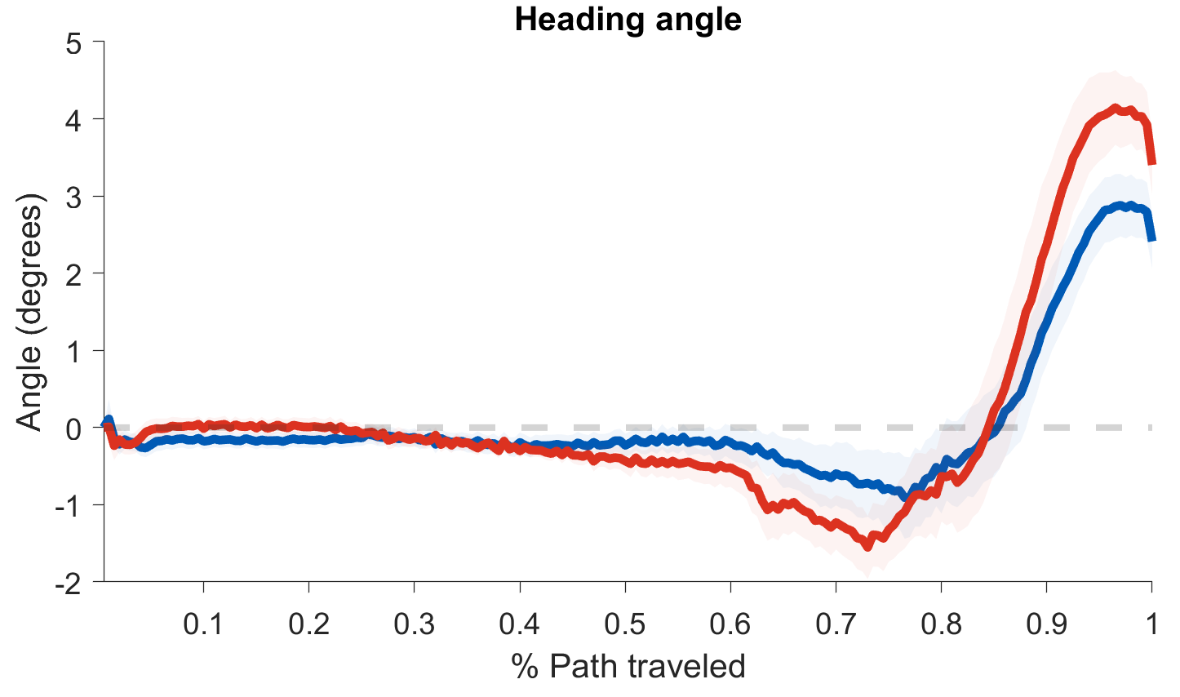
Open Questions
Heading angle
X STD
Notes:
Less incorrect – Participants can change their mind. Can reflect UC effect of prime.
Online information – opens the door for further investigations about the temporal dynamic of UC processing.
Rich data – allows to examine aspects of cognitive processes, unavailable when using keyboard.

Slide 32
Jason might ask about changing the onset of subject movement to better delineate the timecourse of the UC effect.

Slide 33
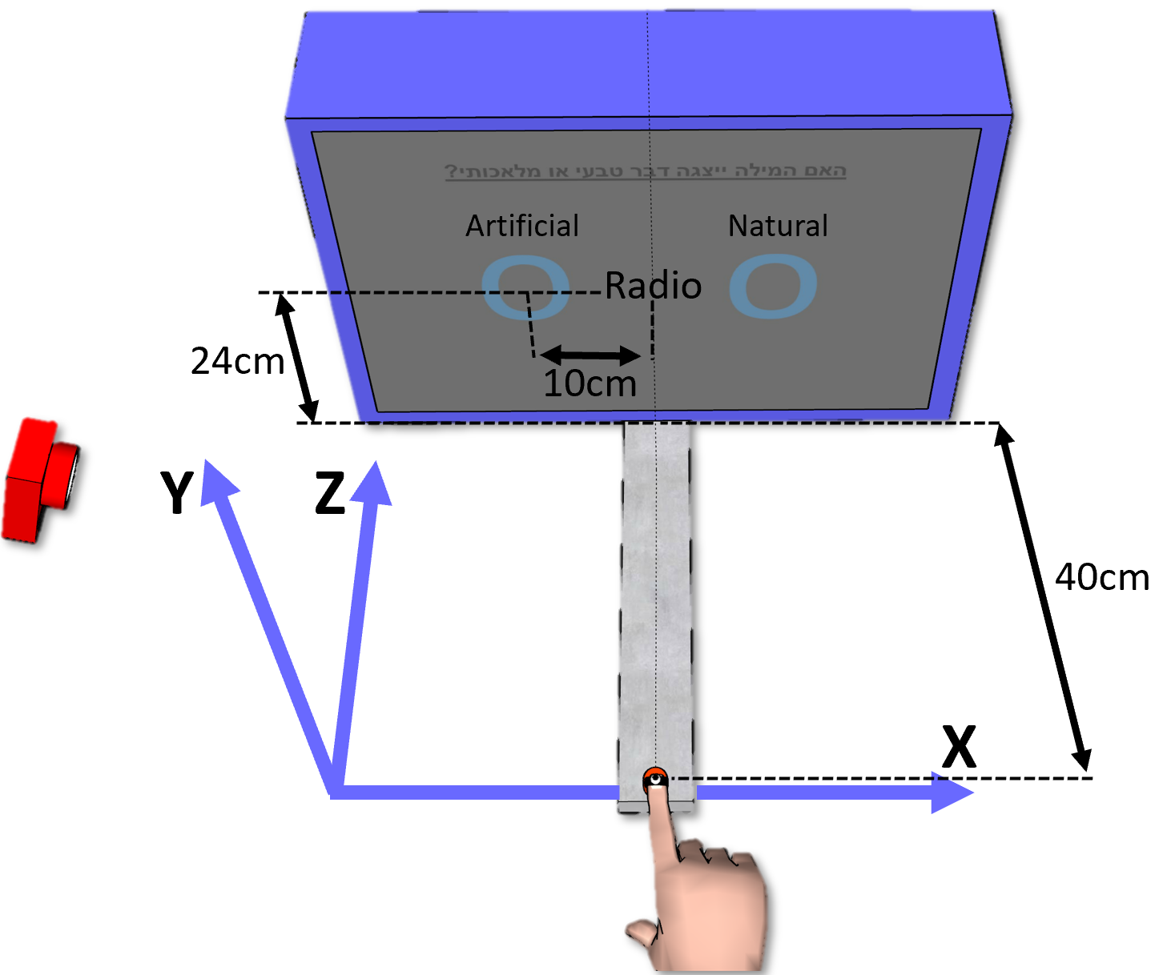

Slide 34
Make a slide about preprocessing

Slide 35
Slide about exclusion criteria

Slide 36
Remember which feed back was given to which exp
RT limit of each exp

Slide 37
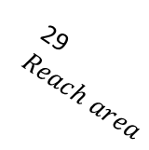
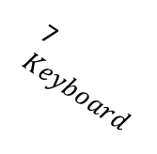
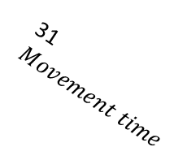
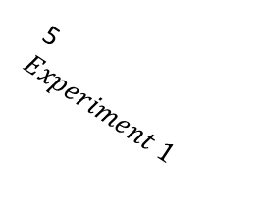
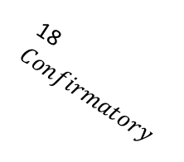
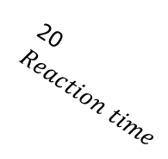


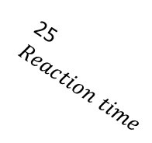
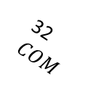
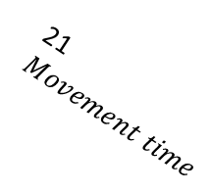
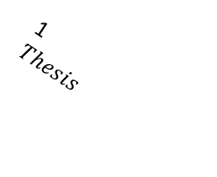
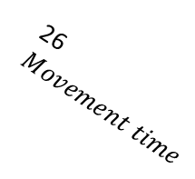
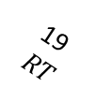

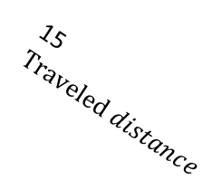
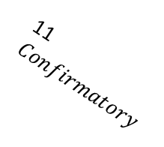
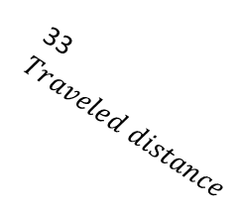

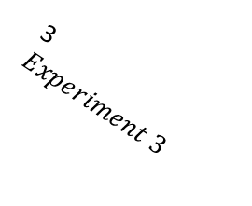

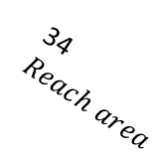
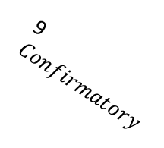

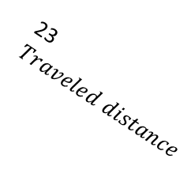
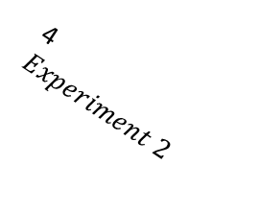
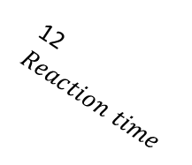
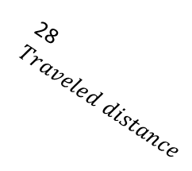

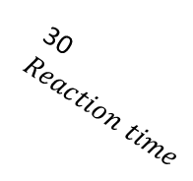
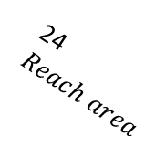
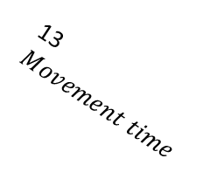
1
$Thesis$
2
Experiment 4
3
$Experiment 3$
4
$Experiment 2$
5
$Experiment 1$
6
Reach
7$Keyboard$
8$Exploratory$
14$COM$
15$Traveled distance$
16$Reach area$
9
$Confirmatory$
10$Exploratory$
11$Confirmatory$
12$Reaction time$
13$Movement time$
19$RT$
20$Reaction time$
21$Movement time$
22$COM$
23$Traveled distance$
24$Reach area$
25$Reaction time$
17$Exploratory$
18$Confirmatory$
26$Movement time$
27$COM$
28$Traveled distance$
29$Reach area$
30$Reaction time$
31$Movement time$
32$COM$
33$Traveled distance$
34$Reach area$

